Slide 1
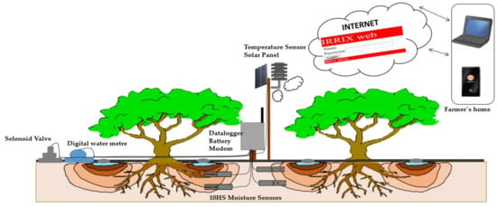
sustainable automated irrigation system

Slide 2
INTRODUCTION
An 'automated irrigation system' operates with no or very little manual intervention aside from surveillance. The demand for irrigation water in agricultural systems is an important area of concern, especially given the growing scarcity of available water resources and the need to compete with other consumer sectors.

Slide 3
MOTIVATION
Farmers on big scale or small scale used to face multiple issues on not being able to take care of plants due to busy schedule and that they find it hard to know what's wrong with their plants when it has diseases so they don’t know proper method to take care.

Slide 4
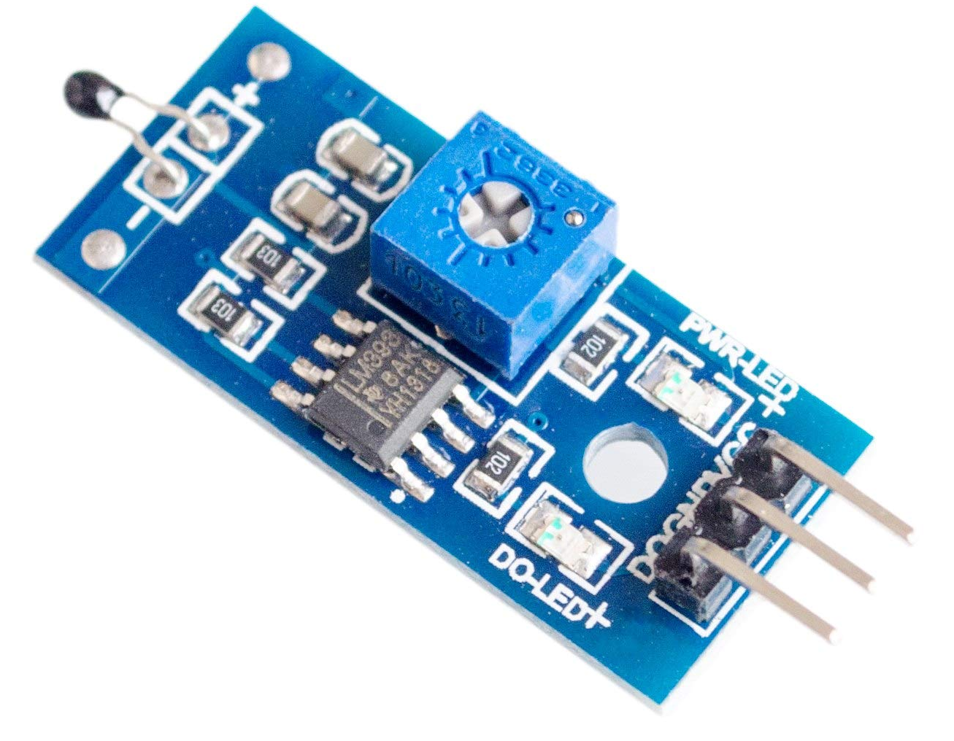

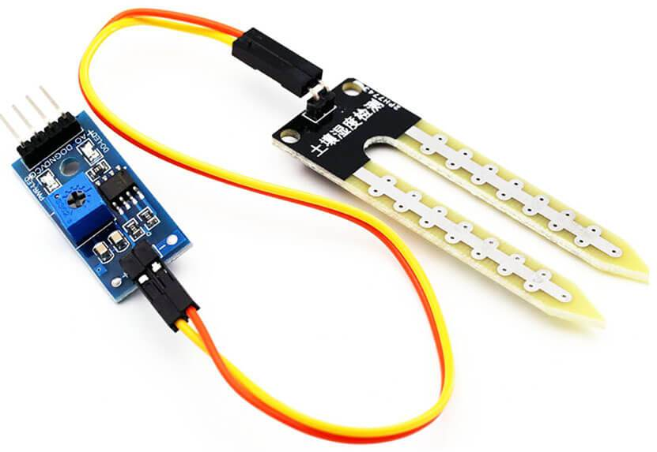
COMPONENTS
Temperature and humidity
Air quality
Soil moisture
Light Sensor

Slide 5
WORKING
Collects data from all the sensors, analysing the data and give plant suggestions and detecting plant diseases using smartphone camera. Basically monitor overall plant health. Automatic irrigation systems must be operated and maintained regularly by skilled laborers. Sensor and valve malfunctions must be avoided at all costs, and common repair work (e.g., leaches, blockages) must also be considered.

Slide 6
Advantages
Automation eliminates the need for manual valve opening and closing.
Use of water from various sources, as well as increased efficiency in water and fertilizer use.
The system can be run at night, reducing water loss due to evaporation.
The irrigation process starts and stops exactly when needed, reducing energy consumption.

